Slide 1
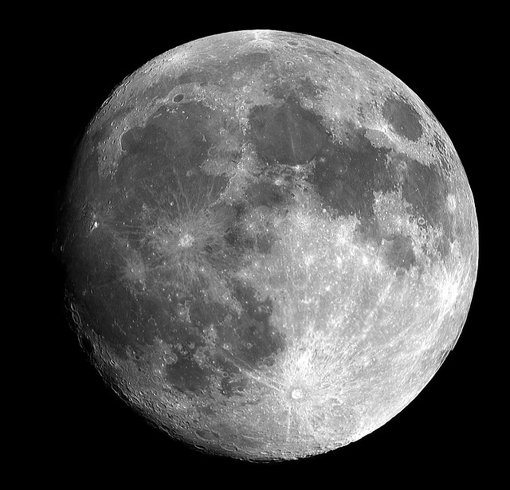
Lunar Cycle
© The Science Duo

Slide 2
Lunar Cycle
It takes the moon 27.3 days to revolve around the Earth one time
The lunar cycle (from new moon back to new moon) takes 29.5 days
The phases of the moon are a reflection of the Sun’s light bouncing off of the moon’s surface
The moon appears to change shape because only certain portions of its illuminated side are seen as the moon revolves around Earth

Slide 3
Moon Phases
There are 8 moon phases
The same moon phase is seen by everyone on Earth each night – people in the northern and southern hemispheres do not see opposite moon phases
The first half of the lunar cycle the light reflected off of the moon’s surface appears to increase
The second half of the lunar cycle the light reflected off of the moon’s surface appears to decrease

Slide 4
New Moon
No reflected light from the sun is visible
Occurs directly after a waning crescent, but before a waxing crescent

Slide 5
Waxing Crescent
Less than half of the moon is visible from Earth
The visible light appears on the right
Occurs directly after a new moon, but before a first quarter

Slide 6
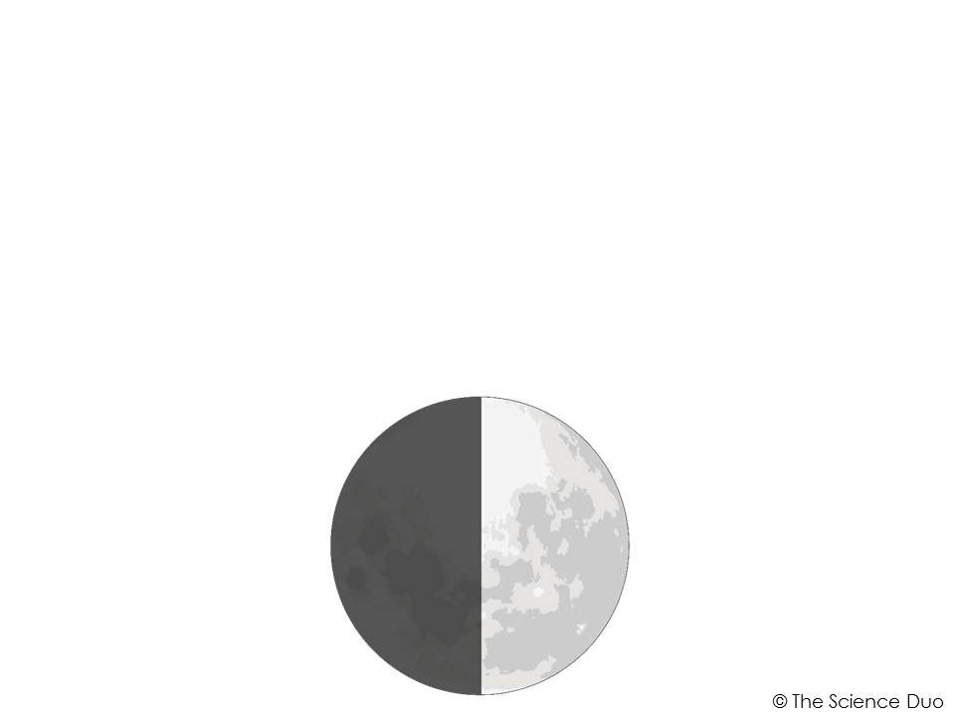
First Quarter
Half of the moon is visible from Earth
The visible light appears on the right
Occurs directly after a waxing crescent, but before a waxing gibbous

Slide 7
Waxing Gibbous
More than half of the moon is visible from Earth
The visible light appears on the right
Occurs directly after a first quarter, but before a full moon

Slide 8
Full Moon
A full moon is fully visible (100% illuminated) as viewed from Earth
Marks the half way point of the lunar cycle
Occurs directly after a waxing gibbous, but before a waning gibbous

Slide 9
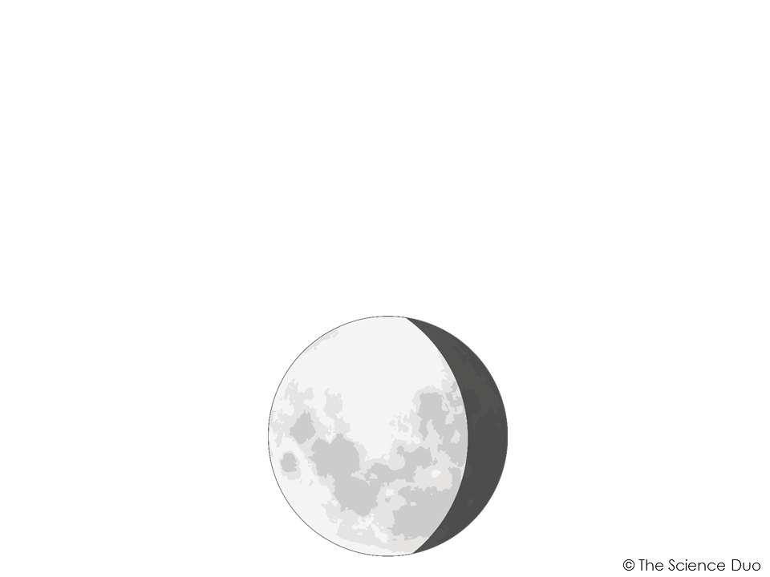
Waning Gibbous
More than half of the moon is visible from Earth
The visible light appears on the left
Occurs directly after a full moon, but before a third/last quarter

Slide 10
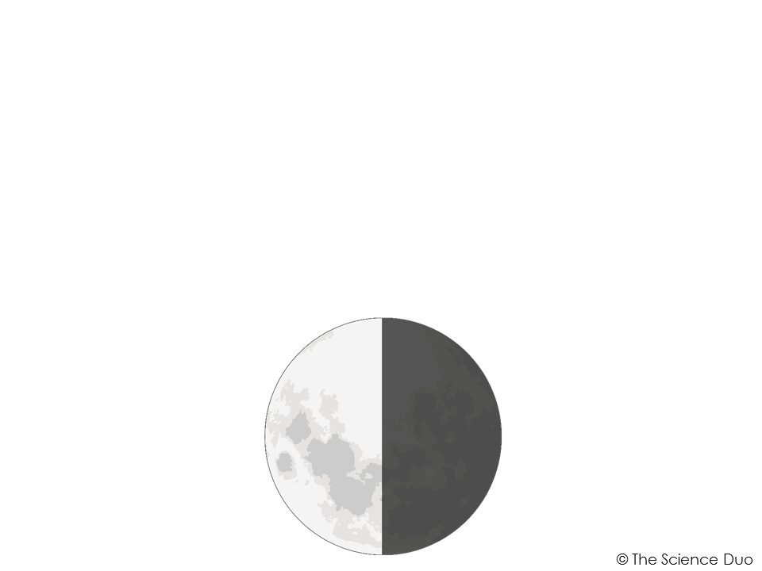
Third Quarter
Half of the moon is visible from Earth
The visible light appears on the left
Occurs directly after a waning gibbous, but before a waning crescent

Slide 11
Waning Crescent
Less than half of the moon is visible from Earth
The visible light appears on the left
Occurs directly after a third/last quarter, but before a new moon

Slide 12
Predicting the Phases
Each ¼ of the cycle takes about 7 days or 1 week to occur
If there was a New Moon on December 10th, there would be a 1st Quarter on December 17th - about 7 days or 1 week later
To move 2 moon phases ahead takes about 7 days or 1 week
If there was a Waxing Crescent on August 7th, there would be a Waxing Gibbous on August 14th - about 7 days or 1 week later

Slide 13
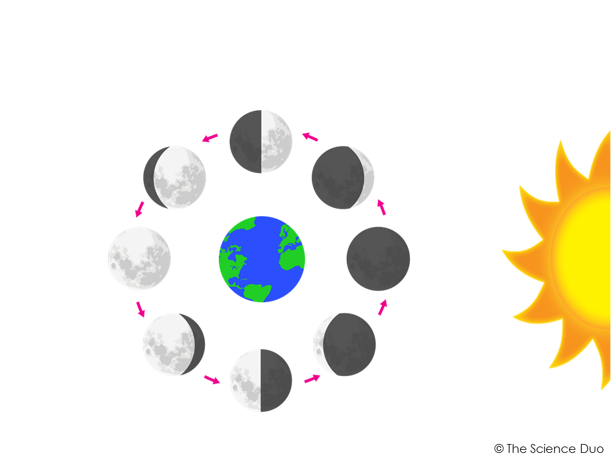
Lunar Cycle Diagram
1st Quarter
Waxing Gibbous
Waxing Crescent
Full
Moon
New
Moon
Waning Gibbous
Waning Crescent
3rd Quarter

Slide 14
Checkpoint
5 checkpoint questions
Discuss each question with a partner
Write a complete answer to each question on your notes page

Slide 15
Question 1
What causes the different phases of the moon as seen from Earth?

Slide 16
Question 2
What is the difference between a waxing moon and a waning moon?

Slide 17
Question 3
How much of the moon is visible from Earth during a new moon phase?

