Slide 1
Properties
of Waves
© The Science Duo

Slide 2
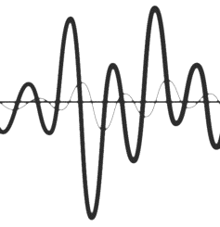
Waves
Disturbances that transfer energy from place to place
Medium – the material through which a wave travels; can be solids, liquids, or gases
Mechanical waves – require a medium to travel (ex. sound)
Electromagnetic waves – can travel through empty space (ex. light)
3 examples of waves – sound, light, and seismic

Slide 3
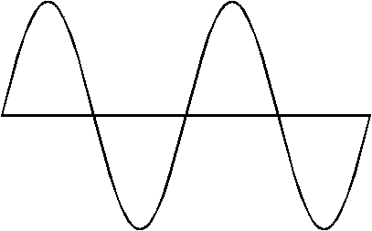
Types of Waves
Transverse – a type of wave that moves the medium at a right angle to the direction in which the wave travels
Longitudinal – a type of wave that displaces the particles of the medium parallel to the direction in which the wave travels
Surface – a combination of transverse and longitudinal waves
Transverse
Longitudinal
Surface

Slide 4
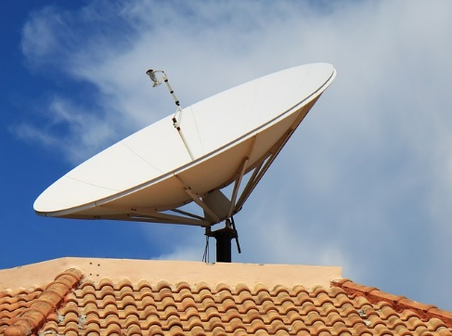
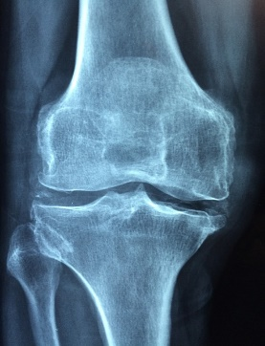
Transverse Waves
Crest – the highest part of a transverse wave
Trough – the lowest part of a transverse wave
Examples of Transverse Waves
Crest
Trough
Visible Light
Radio Wave
X-Ray

Slide 5
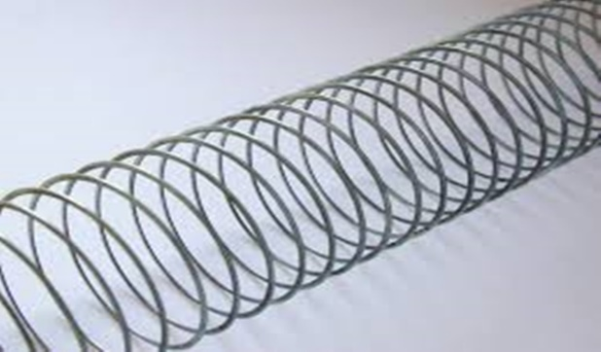
Longitudinal Waves
Compression – the location where the particles are closest together on a longitudinal wave
Rarefaction – the location where the particles are furthest apart on a longitudinal wave
Examples of Longitudinal Waves
Compression
Rarefaction
Sound Wave
Ultrasound Wave
“Slinky” Wave

Slide 6
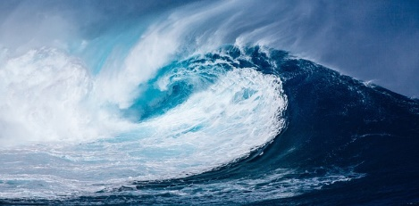
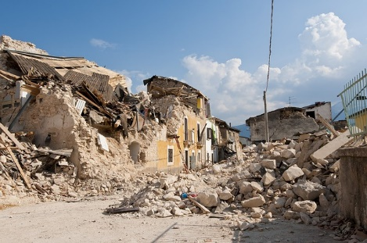
Surface Waves
Energy travels along the surface of the medium
Occur between two media
Travel slowly, but can cause severe damage
Examples of Surface Waves
Ocean Wave
Ripples in Water
Earthquake Wave

Slide 7
Wave Properties
Amplitude – the maximum distance a wave moves away from the rest position
Wavelength – the distance between two corresponding parts of a wave
Frequency – the number of complete waves that pass a given point in a certain amount of time
Speed – the distance a wave travels in one unit of time
Wavelength and frequency have an inverse relationship. As the wavelength increases, the frequency will decrease and vice versa.

Slide 8
Wave Diagram
The example below is a transverse wave
Crest
Wavelength
1 sec.
0 sec.
Amplitude
Rest Position
Trough
Frequency = 2 Hertz

Slide 9
Assignment
Answer each question on and send it to me.

Slide 10
Question 1
Describe waves in your own words.

Slide 11
Question 2
Identify 3 different types of media that waves use to travel.

Slide 12
Question 3
What do you think the rest position of a wave represents?

Slide 13
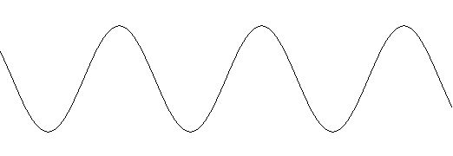
Question 4
Identify Point A and Point B.
B
A

Slide 14
Question 5
Why do you think it is important to understand the different types of waves?

